Slide 1
Problems
Posed by Ad Blockers
Robert Gabriel
Web Trends & Culture
Notes:
Next Slide : What is adblocking
The befinits -> to the effect it has -> the soultions

Slide 2
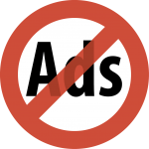
What is Ad blocking
Ad blocking is defined as software that removes or alters advertising content on a web page, most commonly in the form of browser extensions.
Notes:
NEXT : Types of Ads Say what type of ads it blocks
List examples

Slide 3

Types Of Ads
Pictures
Animations
Embedded
Audio and Video
Text
Pop-up windows
Notes:
Next is benfits

Slide 4

Benefits To The User
Quicker loading
Cleaner looking web pages
Free from advertisements
Less resource waste
Privacy benefits .
Save substantial amounts of energy.
Notes:
Next Growth

Slide 5
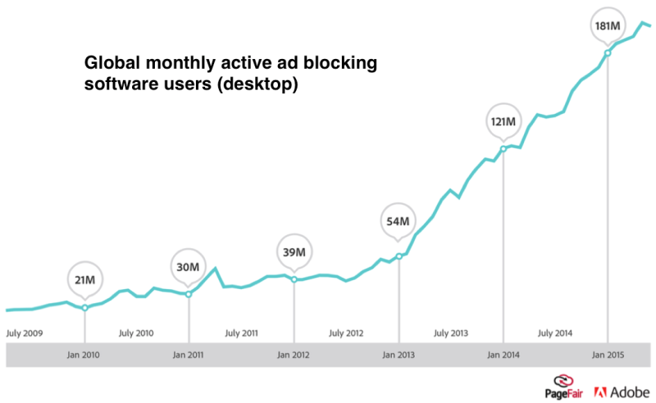
Growth
Ad blocking saw 41 percent growth year over year.
In the US
Usage grew 48 percent
45 million active users
20% of users on the web use adblockers
Notes:
Next is performance
Mention ios 9 will increase the use and rise of ad blockers
cousins.

Slide 6
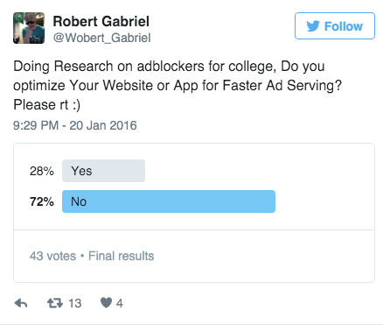
Performance
The majority of web developers
Do not prioritise this
Easy to see why users would opt for adblockers.

Slide 7
Performance
Using Adblock has a major impact on startup performance.
The Los Angeles Times
Speed | Size
11 | 5.7 Mb
4 | 1.6mb
*using Imore
Notes:
Performance / Next is Tracking
Will talk about a survey in a small bit about sites not caring

Slide 8

Tracking
There are multiple websites tracking your online activity and browsing history.
Most business are reliant on this tracking in order to expand and sell you ads.
Notes:
Better to understand you, ad blockers stop this Sell you more ads
People dont like this aswell
Mention google mail - bikes or amazon

Slide 9

Security
Third party advertisements can present a serious threat to computer security.
In high-profile case malware was distributed through advertisements provided to YouTube by a malicious customer of Google's Doubleclick.
Notes:
More Security -> After
Youtube double click

Slide 10

Security
Forbes requires users to disable ad blocking before viewing their website, whereupon some users were immediately served with pop-under malware.

Slide 11

Problems
Posed by Ad Blockers
Adblockers present a massive threat to all internet businesses, which is a problem because online industries play a huge role in the global economy.

Slide 12
Problems
Posed by Ad Blockers
Free access NO MORE
Quality GONE
Incomplete information
Not understanding the customer
Loss of Revenue

Slide 13
Problems
Posed by Ad Blockers
Example
An ad is displayed on a website but is ignored, that doesn't provide value for the web owner. If users ignore advertisements.
As a result, sites are rarely paid “per click”.
Instead, the standard metric for selling web display ads is “CPM”, or “cost per mille”—the cost for a thousand views.

Slide 14
Problems
Posed by Ad Blockers
“For a website that serves 5 million page views per day, with three ads per page, sold at a rate of €5 CPM, ad blocking could translate into daily losses of €7,500 ”

Slide 15
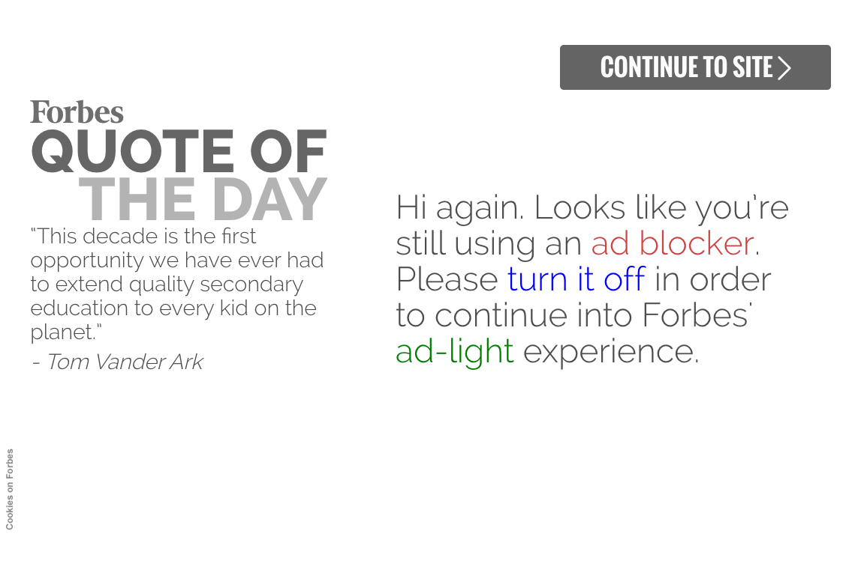
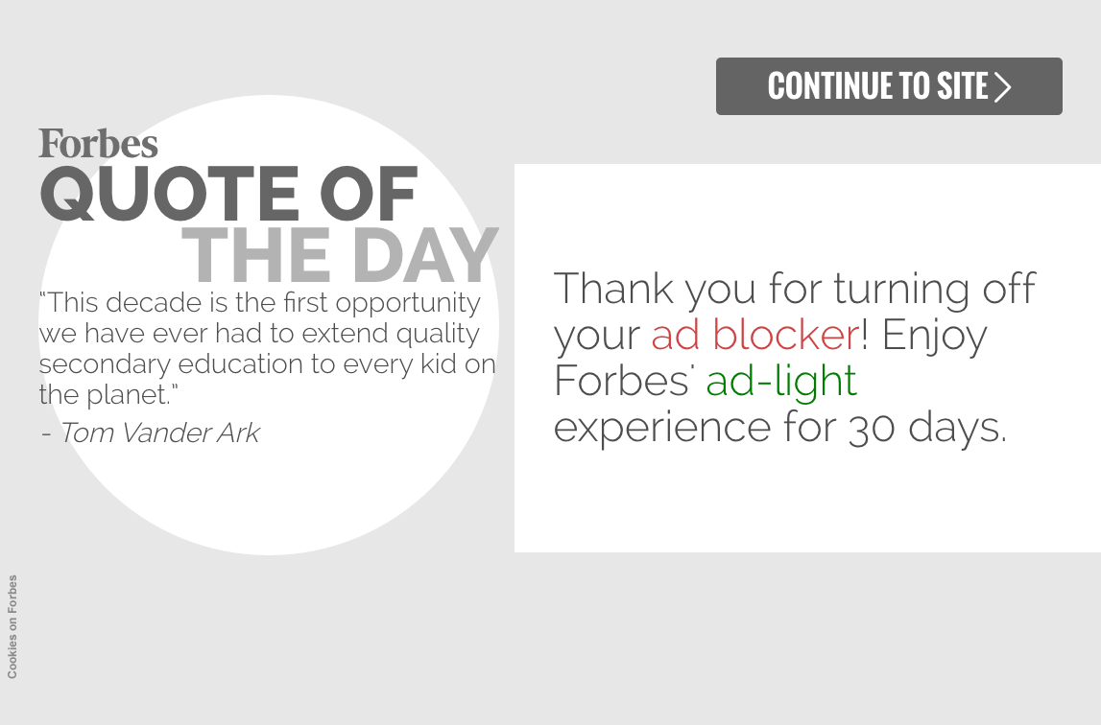
Fighting Adblockers

Slide 16
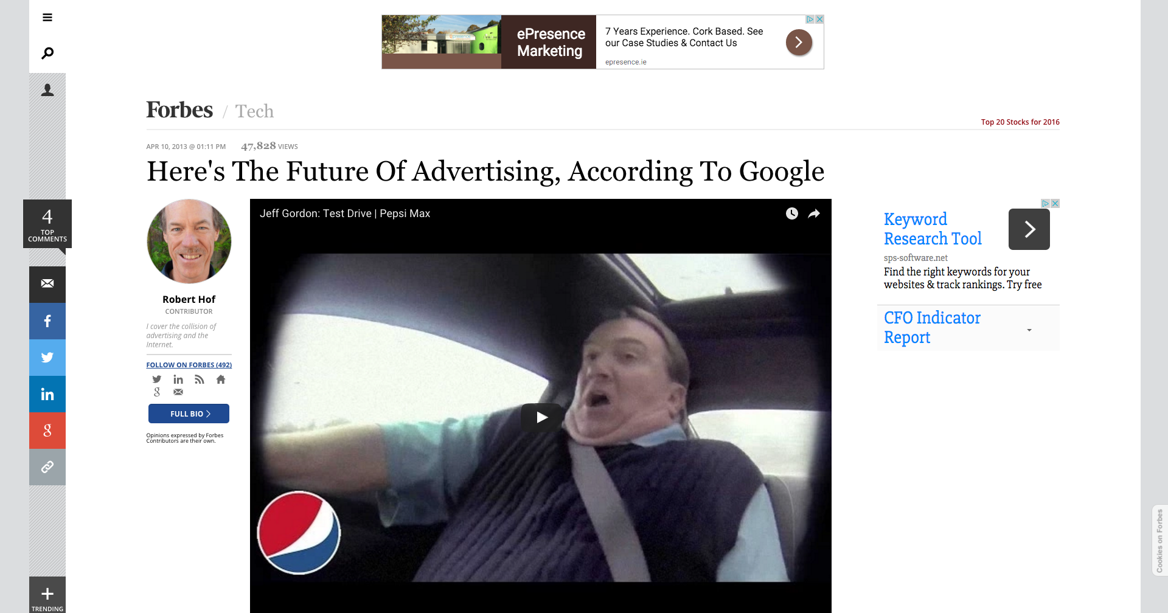
What the article looks like

Slide 17
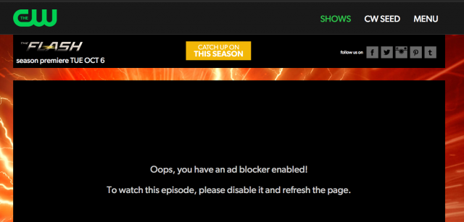

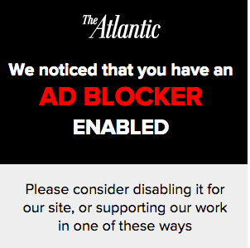
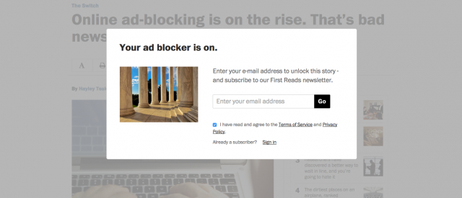

Other Examples

Slide 18




Some Websites Who Run On Ads
The following companies are free, but they track you to sell you ads or build features.

Slide 19
Ads Should be
Not annoying.
Do not disrupt or distort the page content we’re trying to read.
Transparent with us about being an ad.
Effective without shouting at us.
Appropriate to the site that we are on.
Unfortunately, many websites do not follow these rules.

Slide 20
The Future
As stated by the Google's senior vice president of advertising Susan Wojcicki.
Ad views will be voluntary.
Users will participate in the ecosystem if we provide enough value and control.
Ads will be more interactive and beautiful–at scale.
Ads will help people live their lives on the go.
From 2013

Slide 21
Possible solutions
The Freemium Model
Subscription Model
Go Native
Pay the Ad Blockers
Ask Audiences for Sympathy
Block Content From People Who Use Ad Blockers
Offer Ads Free versions
“ You can subscribe to a brand-new Ad-Free version of WIRED.com. For $1 a week, you will get complete access to our content, with no display advertising or ad tracking. “
Notes:
The Freemium Model
Subscription Model
Go Native
Pay the Ad Blockers
Ask Audiences for Sympathy
Block Content From People Who Use Ad Blockers
Offer Ads Free versions

Slide 22
Question and Answers

